Slide 1
DockNStock
Francesco Sidella - 2204034
Giovanni Canedoli - 1991710
Linda Labonia - 2219714

Slide 2
Idea
DockNStock is a distributed retail platform that connects supermarkets with end customers.
The system allows customers to register and log in, browse products, like them, comment on them and manage a shopping cart to place orders.
Supermarkets can register on the platform, receive incoming orders and manage their catalogs by adding and modifying products.

Slide 3
User Stories

Slide 4
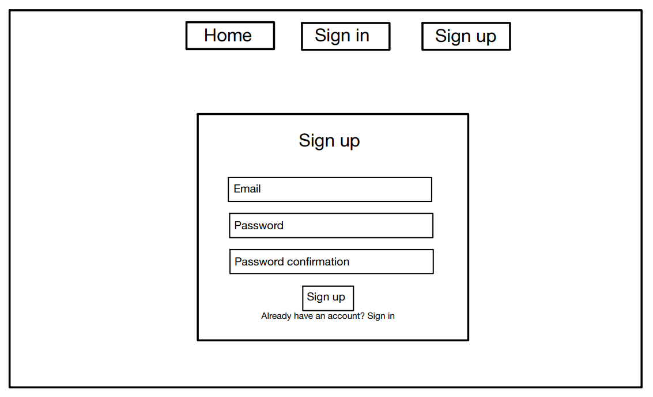
Sign up
As a Customer, I want to register, so that I can create my profile
As a Supermarket, I want to register, so that I can create my business account

Slide 5
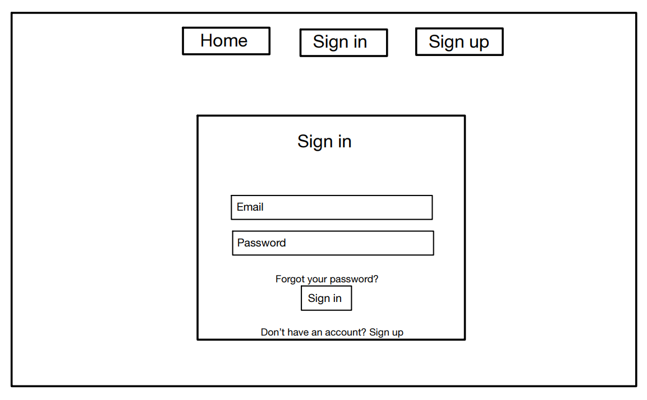
Sign in
As a Customer, I want to login, so that I can access the service
As a Customer, I want to logout, so that I can end my session securely
As a Supermarket, I want to login, so that I can manage my catalog and orders
As a Supermarket, I want to logout, so that I can end my session securely

Slide 6
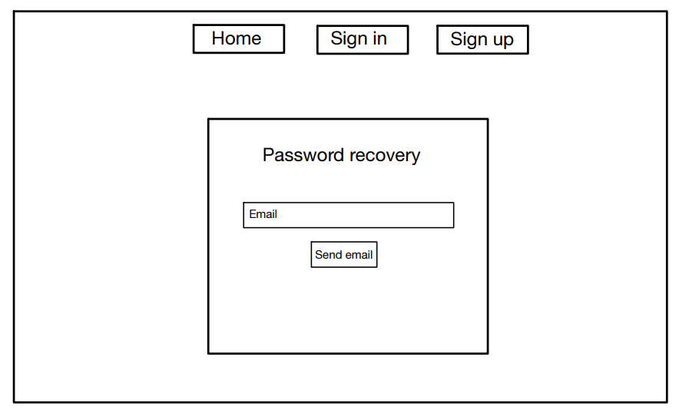
Password recovery
As a Customer, I want to recover my password, so that I can regain access to my account
As a Supermarket, I want to recover my password, so that I can regain access to my account

Slide 7
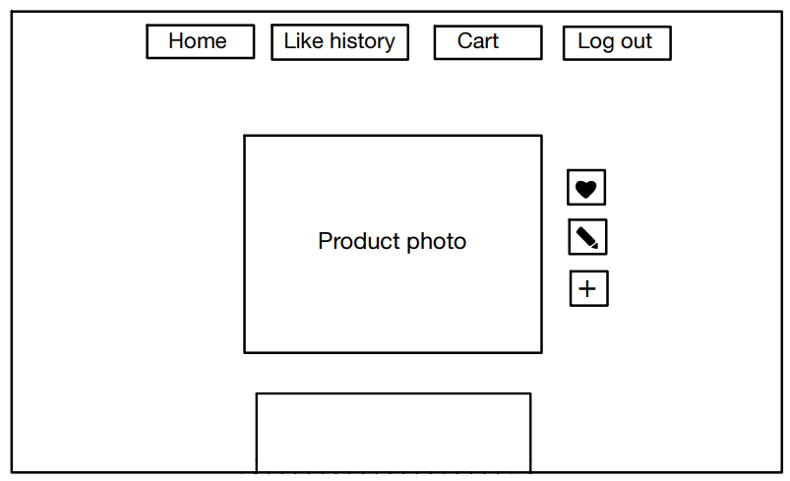
Product catalog
As a Customer, I want to view all available products, so that I can choose what to buy
As a Customer, I want to like a product, so that I can express my preference
As a Customer, I want to unlike a product, so that I can change my mind
As a Customer, I want to add products to my cart, so that I can prepare for checkout

Slide 8
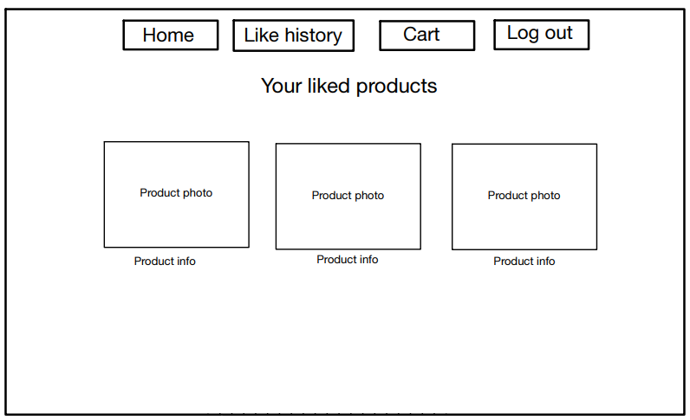
Likes
As a Customer, I want to view the list of liked products, so that I can access them quickly
As a Customer, I want to view product details, so that I can evaluate them before buying

Slide 9
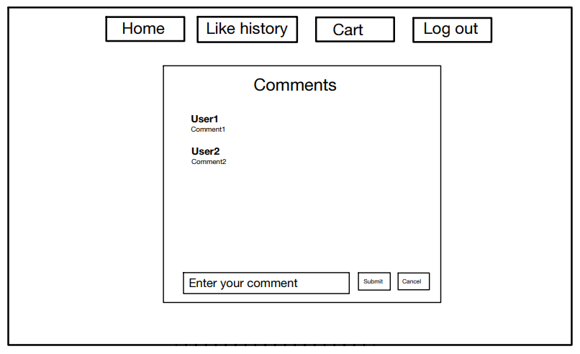
Comments
As a Customer, I want to comment on a product, so that I can share my opinion
As a Customer, I want to view product comments, so that I can read other users’ feedback

Slide 10
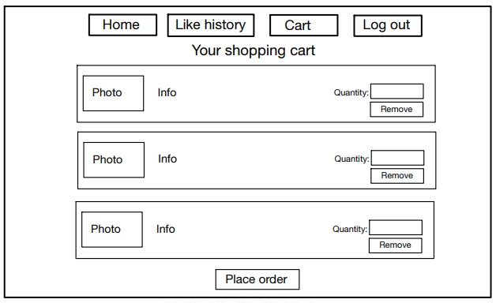
Shopping cart
As a Customer, I want to remove products from my cart, so that I can adjust my order
As a Customer, I want to view all products in my cart, so that I can review my selection
As a Customer, I want to select the quantity of each product in my cart, so that I can customize my purchase
As a Customer, I want to submit my cart, so that I can place an order
As a Customer, I want to receive a confirmation message when the order is placed, so that I know it was successful
As a Customer, I want to receive an error message if the requested quantity is not available, so that I can adjust my cart

Slide 11
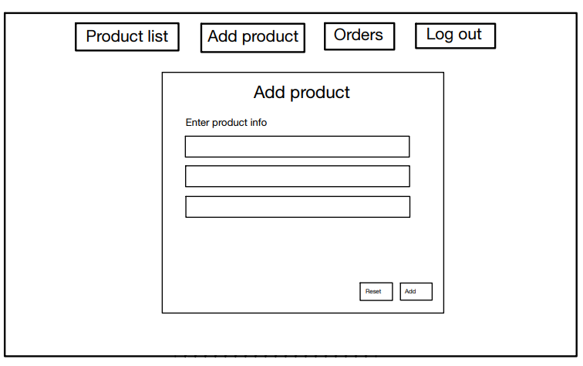
Add products
As a Supermarket, I want to add new products, so that I can expand my catalog

Slide 12
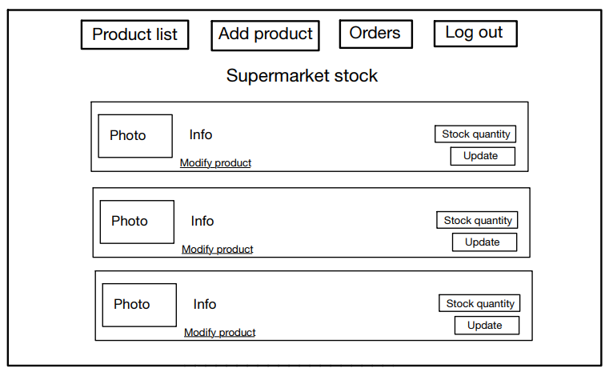
Supermarkets stock
As a Supermarket, I want to view the list of all my products, so that I can manage and monitor my catalog
As a Supermarket, I want to update the details of my products, so that the catalog is always accurate
As a Supermarket, I want to update only the quantity of a product, so that stock levels are kept accurate

Slide 13
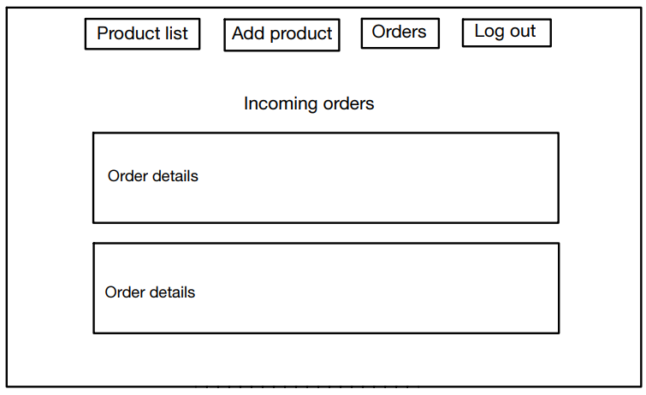
Orders
As a Supermarket, I want to view received orders, so that I can process them

Slide 14
Effort & Work Progress Overview

Slide 15
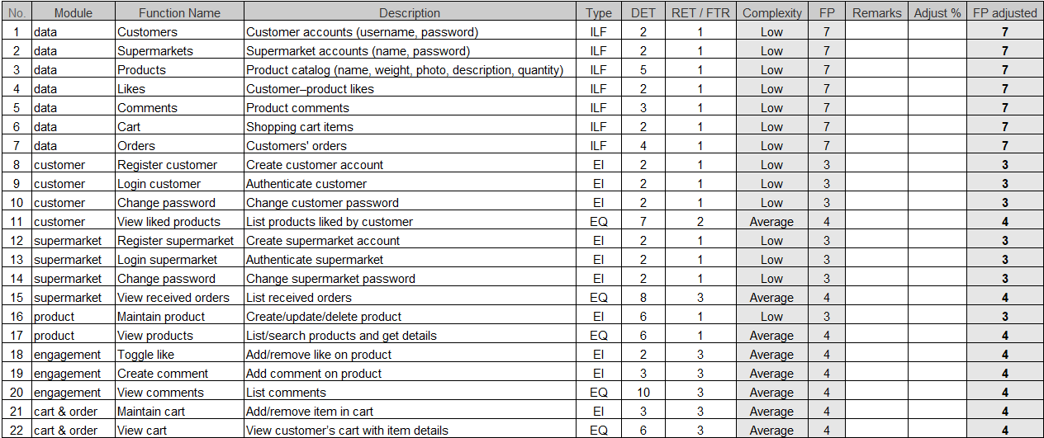
Function Points
& COCOMO II
Adjusted Function Points (AFP): 109
Equivalent SLOC (Python, 21 SLOC/FP): ~2292
Effort (PM): ~6.4 person-months
Schedule (Duration): ~6.4 months
Average team size: ~1 full-time developer

Slide 16
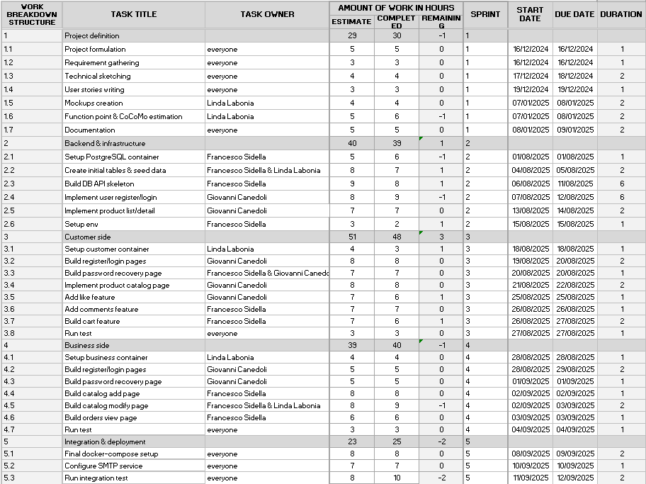
Work Breakdown Structure
Project divided into 5 main work packages
Tasks distributed across 5 sprints
Each task with estimated and completed hours
Clear assignment of responsibilities to team members

Slide 17
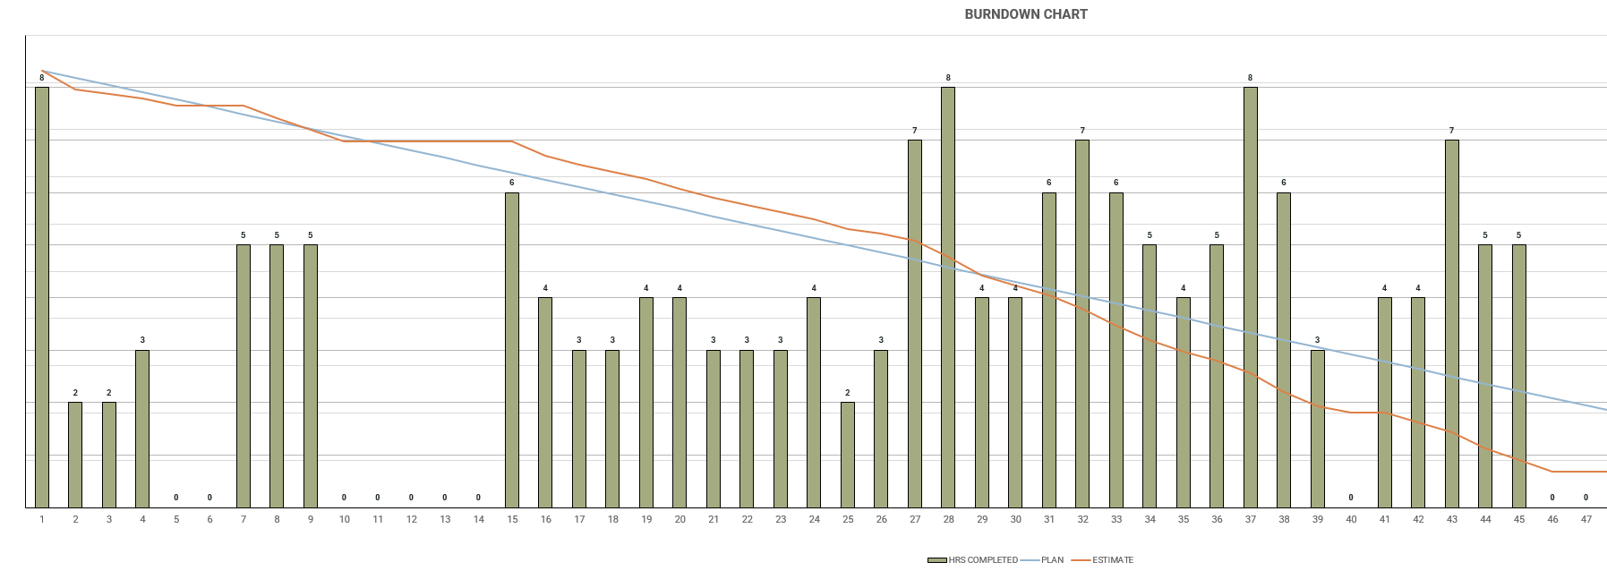
Burndown Chart
185 Estimated Hours
189 Completed Hours

Slide 18
System
Architecture

Slide 19
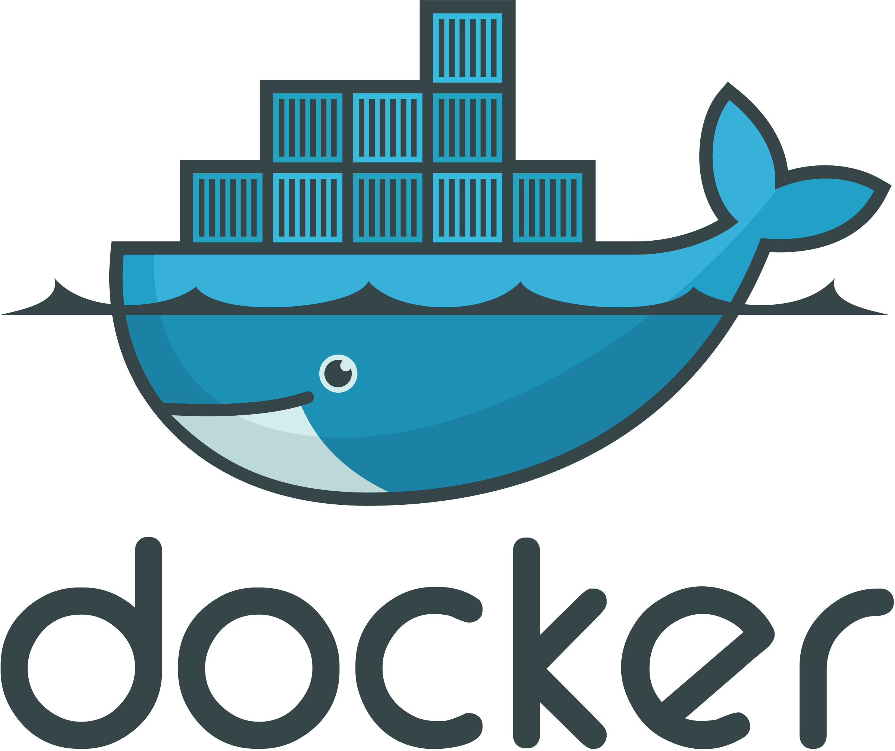
Technologies
The architecture is based on microservices, each process is running in its own docker container and they are orchestrated with docker-compose

Slide 20


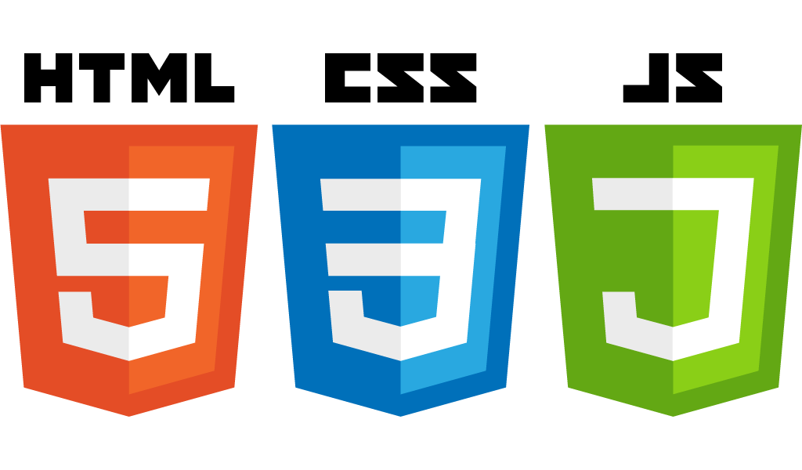


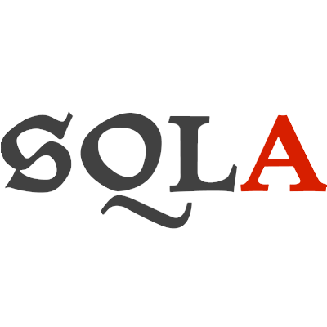

Docker Containers
Two Front End Containers
One API Layer Container
One State Management Container

Slide 21
Technologies
We use Flask and Jinja to render pages server side and push them to our users with the front end containers

Slide 22
Technologies
We use SQLAlchemy, an Object-Relational Mapper (ORM) to map our internal objects to our relational database.

Slide 23
Technologies
Data persistence is possible thanks to PostgreSQL, a relational database that provides data consistency and reliability.

Slide 24
Front End
Business Service: Interface for supermarkets, manages products, their availability and orders from the customers
Customer Service: Interface for buyers, displays the products from every single supermarket, allows the user to save any interesting items and to put them in a shopping cart to buy them from the respective supermarkets

Slide 25
Back End: API Layer
Bridge between the frontend and the database, also provides other utilities for images upload, user registration, authentication and account recovery.

Slide 26
Back End: SQL Database and Storage Management
Handled using PostgreSQL. The management of this layer can be handled through the dedicated api or by manually accessing the container using docker and psql.

Slide 27
Thank you

